Slide 1

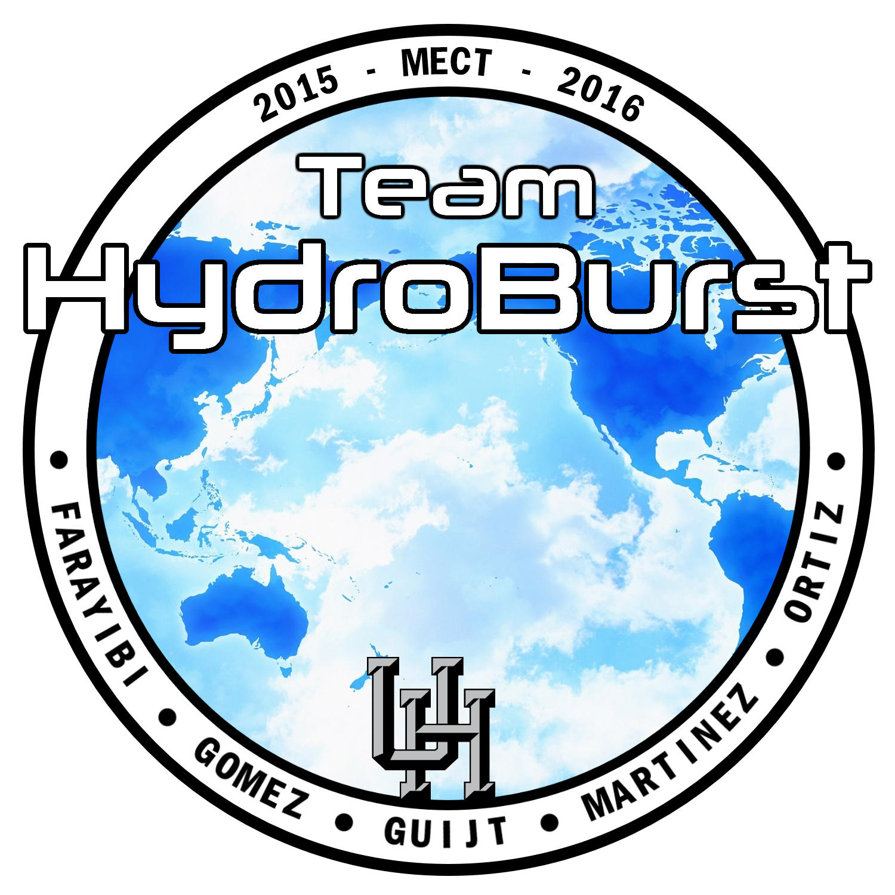
Modular R.O.V for Sub-Sea Operations
Oluyemi Farayibi
Juan Gomez
Gustav Guijt
David Martinez
Victor Ortiz
Project Update 1
10/19/2015
Olly

Slide 2
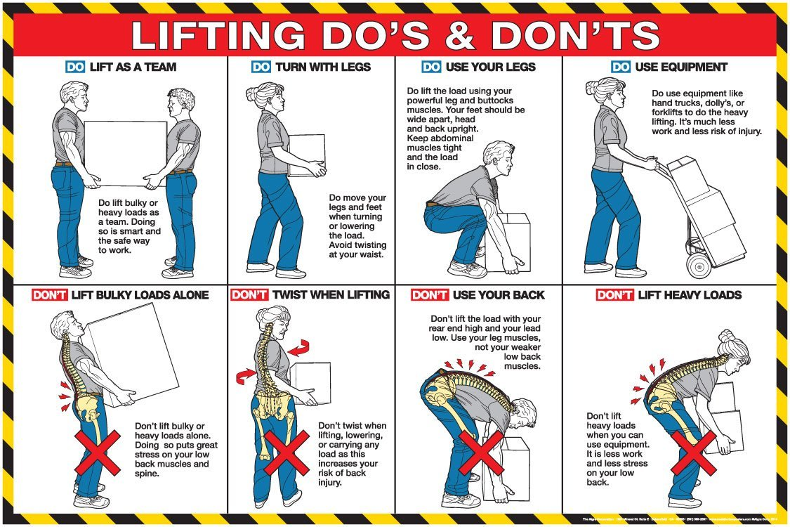
Safety Moment: Do you even lift bro?
Olly

Slide 3
ROV Presentation Outline
Project Objectives / Timeline
2016 MATE Competition
MATE Competition Specs
Design Overview
First Frame Design
Second Frame Design
Stress Analysis – Frame 1
Stress Analysis – Frame 2
Control System
Propulsion System
Thruster Positioning
Arm Update
Updated Project Budget
Olly

Slide 4

Team Objective
Team HydroBurst’s primary objective is to design, test, and construct an underwater remotely operated vehicle (ROV) to compete in the 2016 National and International MATE Competitions.
Olly

Slide 5

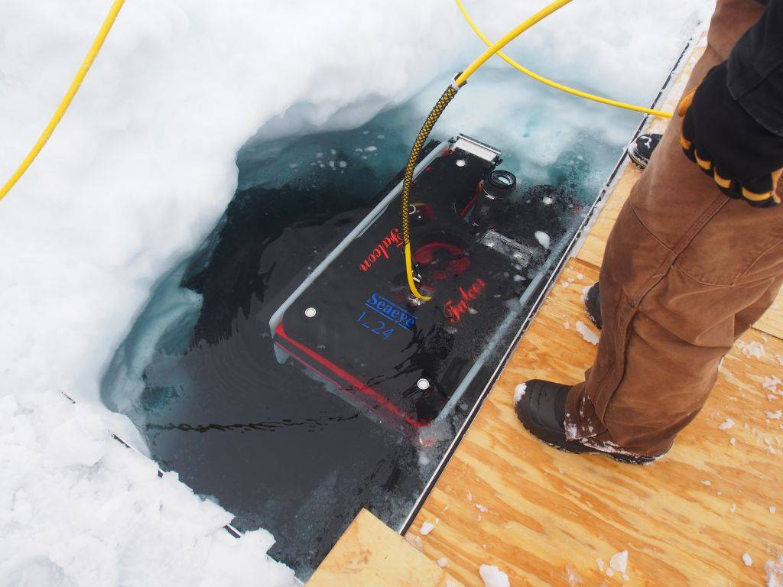
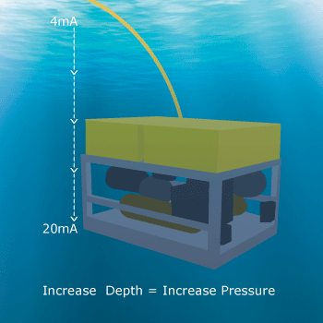
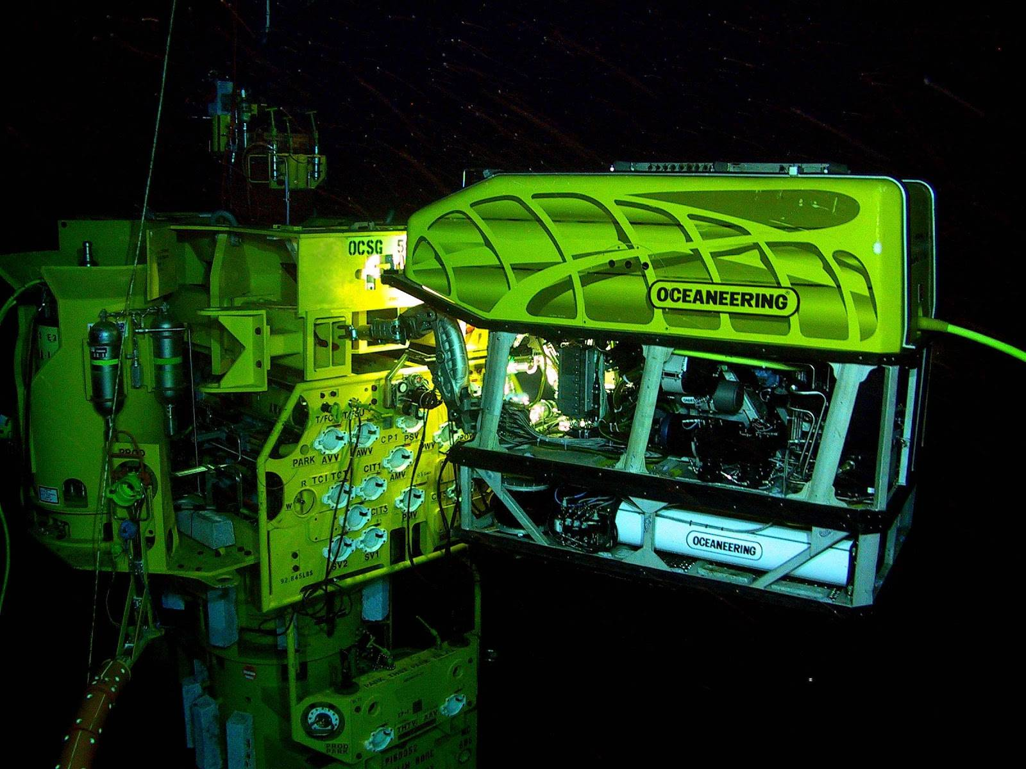
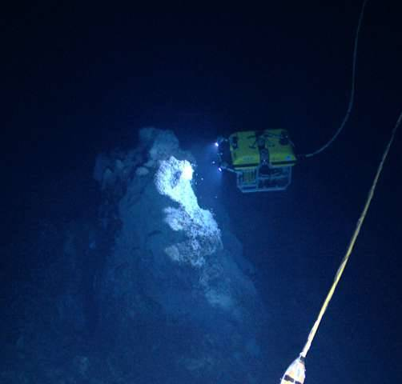
2016 MATE Competition
Outer Space: Mission Europa
Measure thickness of ice
Measure total depth
Measure temp of thermal vents
Retrieve and connect ESP cable
David

Slide 6
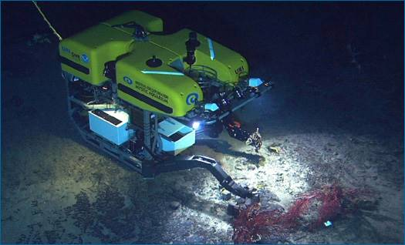
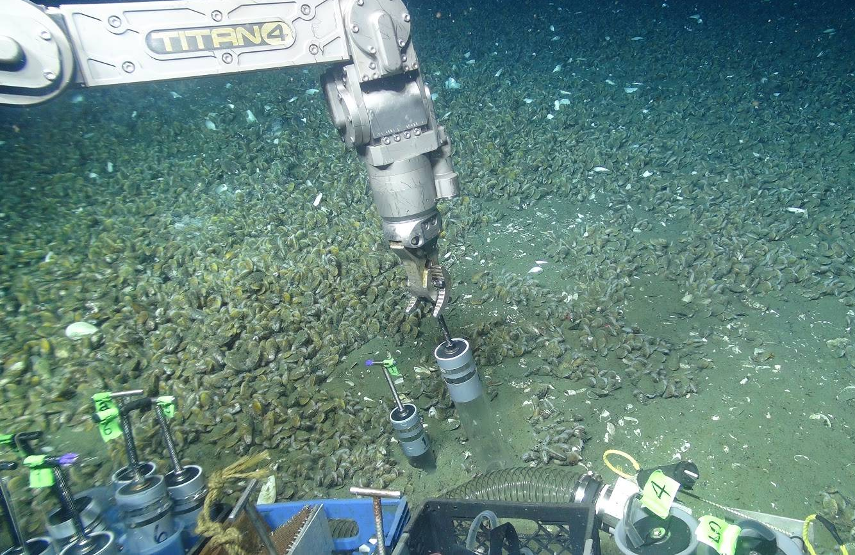
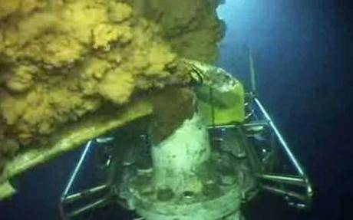
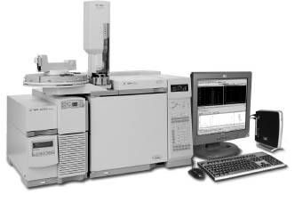
2016 MATE Competition
Inner Space: Mission-critical equipment recovery
Survey the seafloor
Collect equipment located on sea floor
Inner Space: Forensic Fingerprinting
Collect oil sample
Analyze a gas chromatograph
David

Slide 7
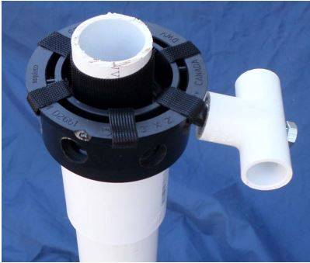
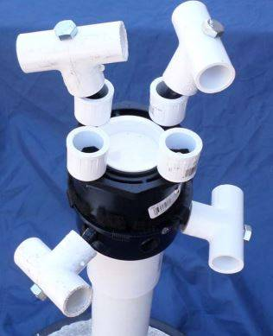
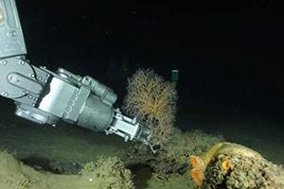
2016 MATE Competition
Inner Space: Deepwater Coral Study
Photograph corals and compare with last years images
Collect coral samples for analysis
Inner Space: Rigs to reefs
Attach a flange to top of wellhead
Secure flange with two bolts
Install cap on flange
Secure the cap with four bolts
David

Slide 8
MATE Competition Specs
Size Constraints (released September 30th):
Maximum Diameter of 85cm
+5 Points for diameter between 64.1cm and 70cm
+10 points for diameter between 58.1cm and 64cm
+20 points for diameter less than 58cm
Mass
+5 Points for mass between 19.01kg and 22kg
+10 points for mass between 17.01kg and 19kg
+20 points for mass less than 17kg
Our Design Goals based on Constraints:
Diameter less than 58cm (22.8346 inches).
Mass less than 17kg (37.4786 lbf)
Gustav

Slide 9
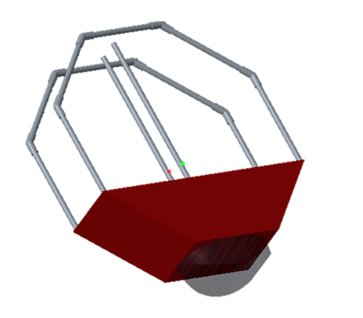
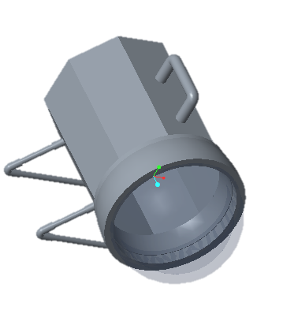
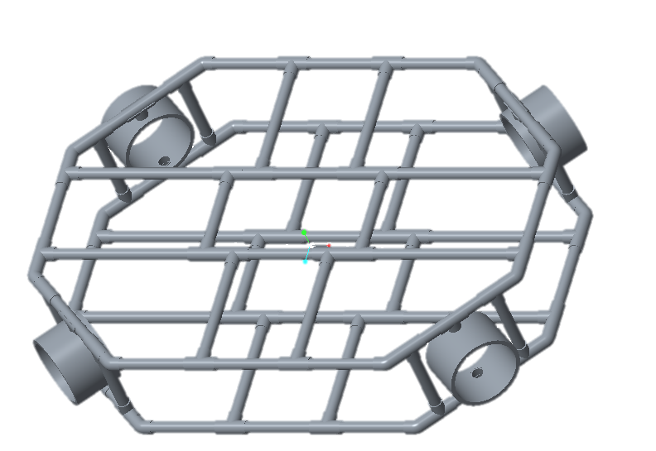
Design Overview
As covered during the last presentation:
we weighed the pros and cons of various standard ROV frame designs.
Decided upon the Octagonal model as the most effective model.
 | Maneuverability | Hydro-dynamics | Internal Space Utilization | Modular Optimization | Corrosion Resistance | Totals
Rectangular | 1 | 1 | 2 | 3 | 5 | 12
Cylindrical | 3 | 4 | 3 | 1 | 5 | 16
Octagonal | 4 | 3 | 2 | 3 | 5 | 17
Flat | 2 | 3 | 3 | 2 | 5 | 16
Gustav

Slide 10
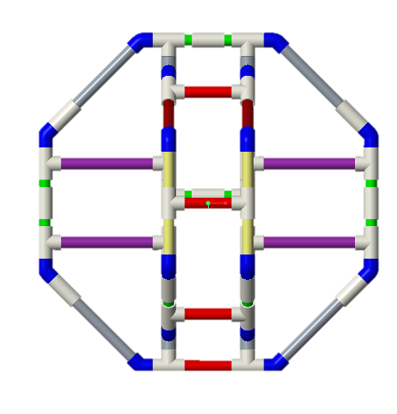
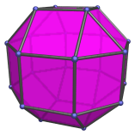
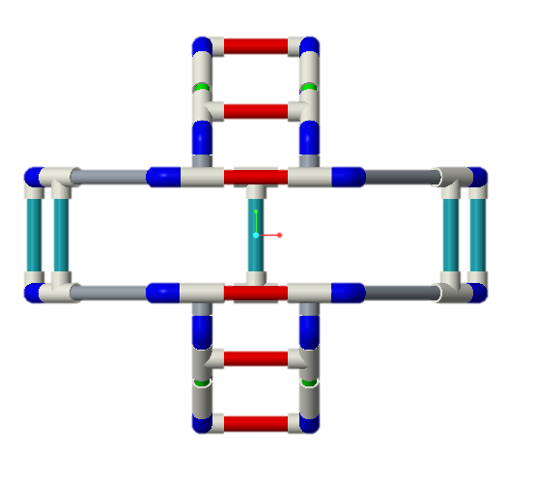
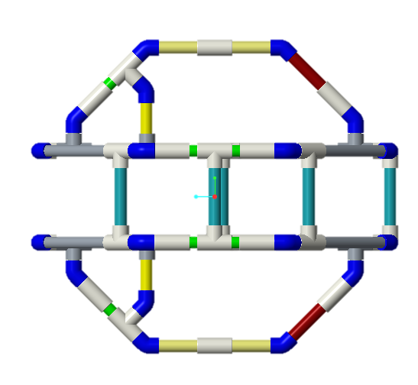
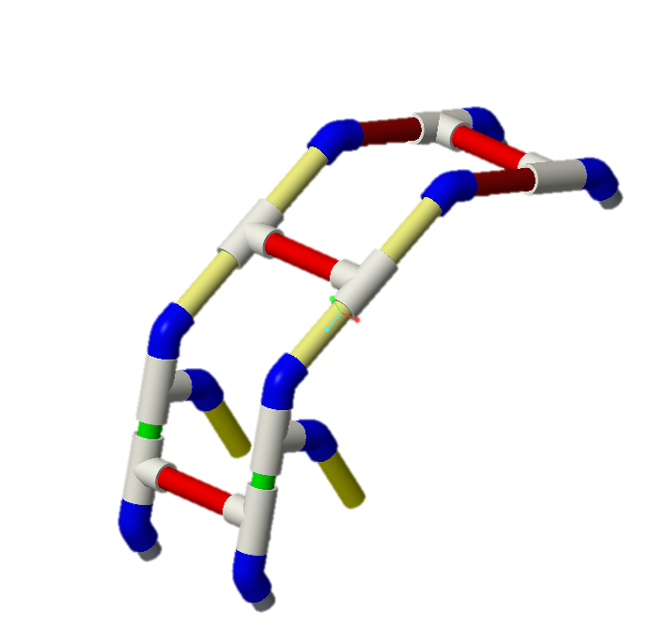
First Frame Design
Shape: Rhombicuboctahedron
To make it as spherical as possible using existing fittings.
Material: CPVC
Light weight, designed for water usage, and can handle high pressures.
Maximum diameter: 21 inches
Minimum of 1.00 inch clearance on all sides.
Frame weight: 4.5 lbs.
Complete Frame Assembly
Gustav
Module (Arms, Sensors, etc…)

Slide 11
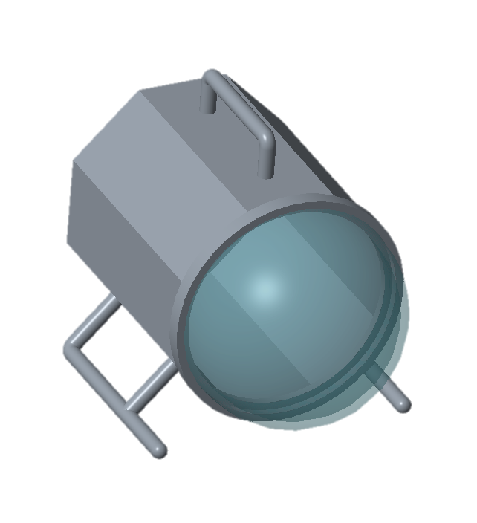
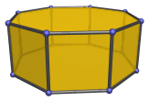
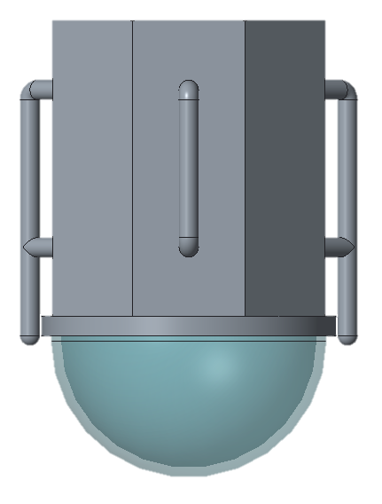
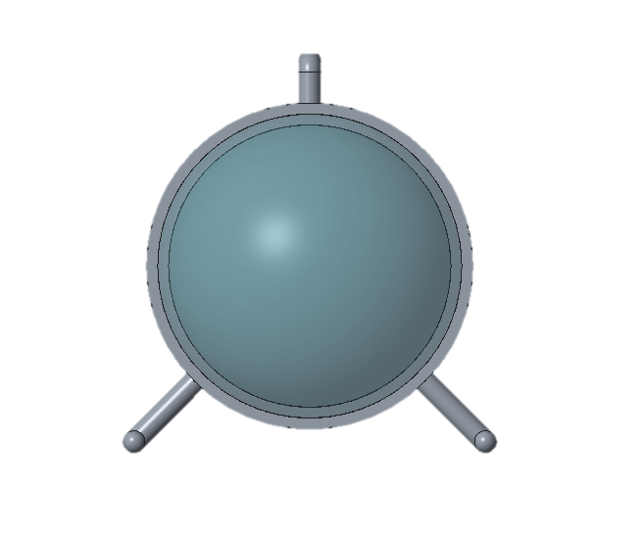
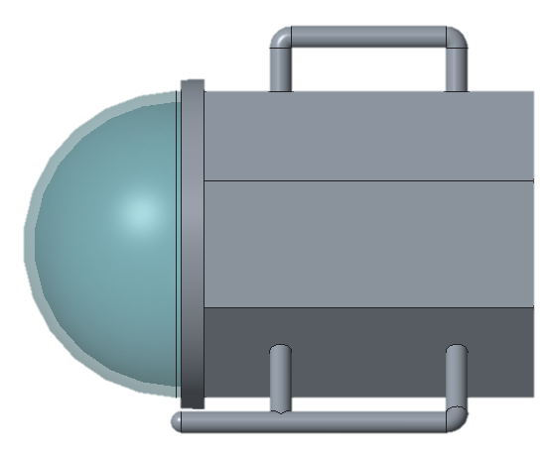
Second Frame Design
Shape: Octagonal Prism.
Solid Frame.
Material: Plastic or Acrylic.
Light weight and strong.
Maximum diameter: 21 inches.
Minimum of 1.00 inch clearance on all sides.
Clear Dome on the front for access and Camera.
Gustav

Slide 12
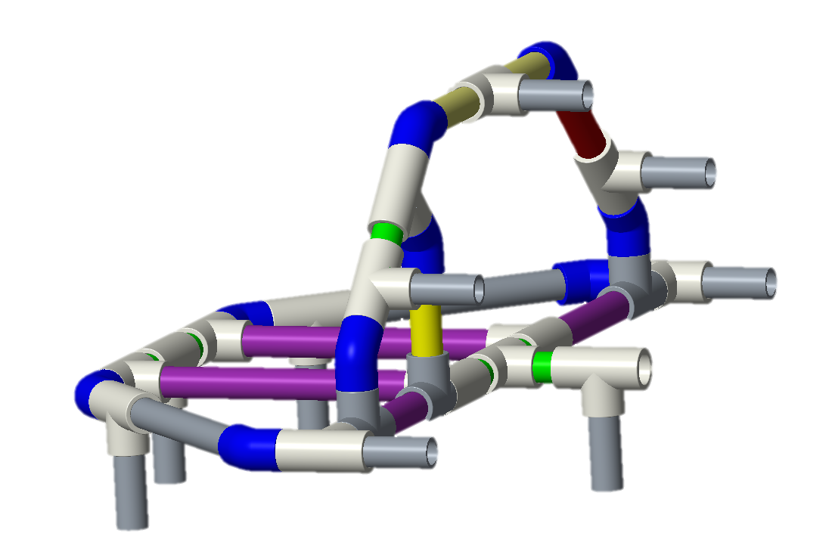
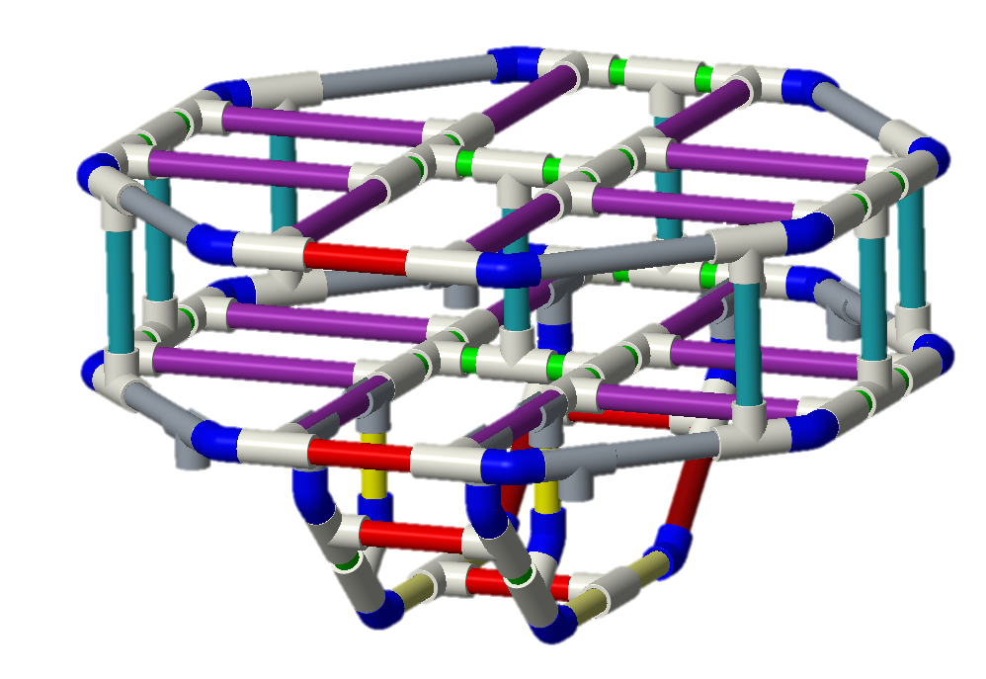
Stress Analysis – Frame 1
Quarter Frame
Full Frame
Juan

Slide 13
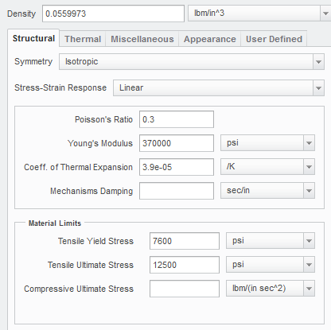
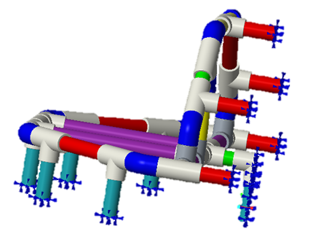
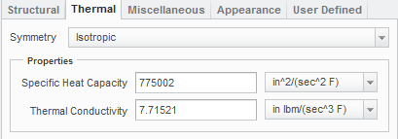
Stress Analysis – Frame 1
Constraints
CPVC Material Definition
Juan

Slide 14
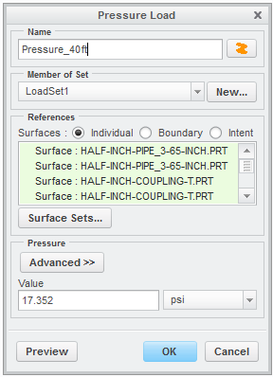
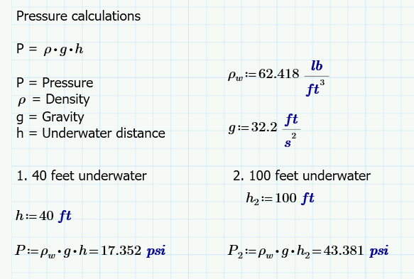
Stress Analysis – Frame 1
Pressure
CPVC Material Assignment
Juan

Slide 15
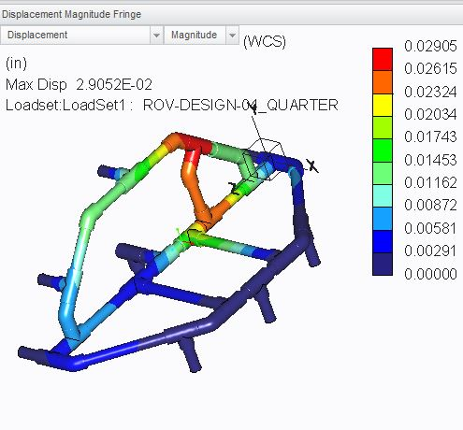
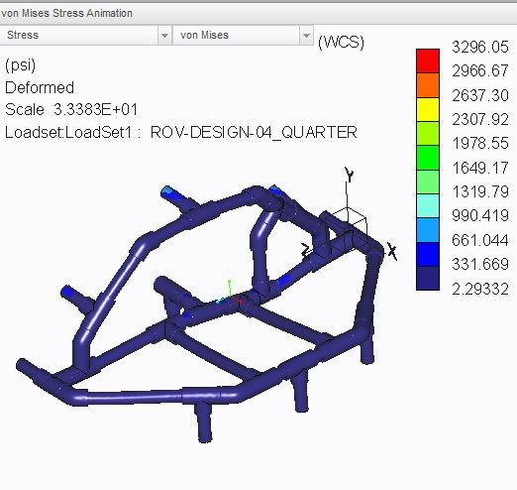
Stress Analysis – Frame 1 40 ft. below water
Displacement (in)
Von Mises Stress (psi)
Juan

Slide 16
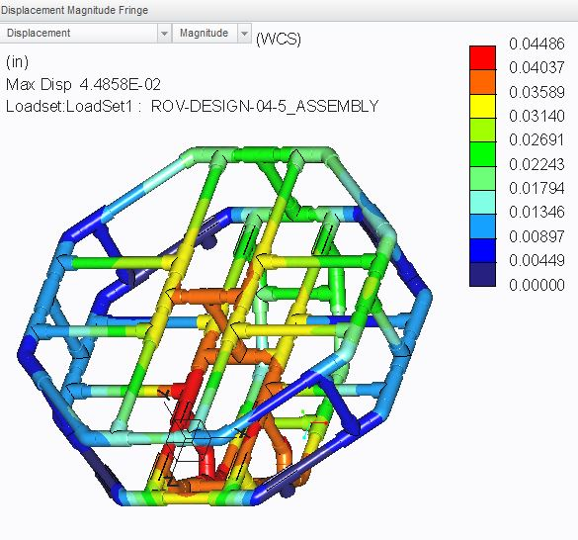
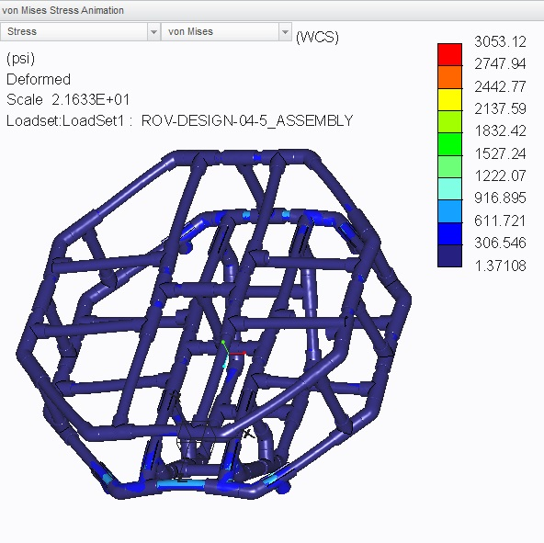
Stress Analysis – Frame 1 40 ft. below water
Displacement (in)
Von Mises Stress (psi)
Juan

Slide 17
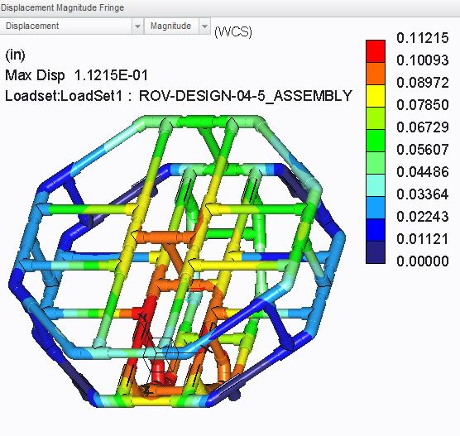
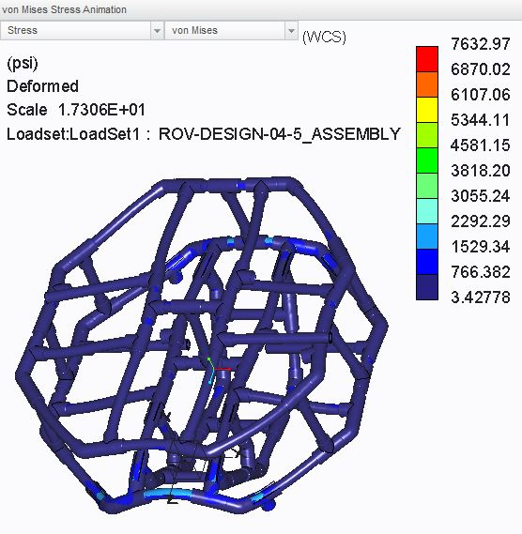
Stress Analysis – Frame 1 100 ft. below water
Displacement (in)
Von Mises Stress (psi)
Juan

Slide 18
Stress Analysis – Frame 1
Model | Max. Von Mises Stress |  | Max. Displacement
 | 40 ft. depth | 100 ft. depth | 40 ft. depth | 100 ft. depth
Quarter Frame | 3296 psi | 9914 psi | 0.029 inches | 0.0734 inches
Full Frame | 3053 psi | 7633 psi | 0.045 inches | 0.112 inches
CPVC Material Properties:
Tensile Strength (Yield Strength) 7,600 psi
Allowable Stress = ⅔ σy 5066.67 psi
Juan

Slide 19
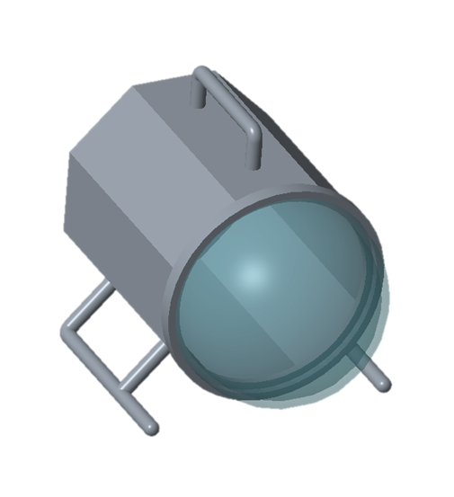
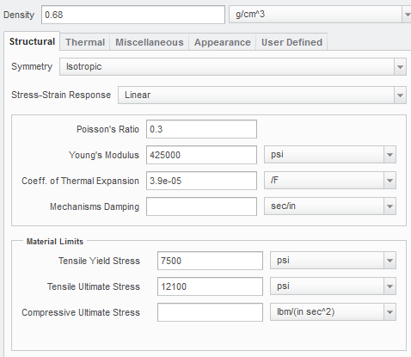
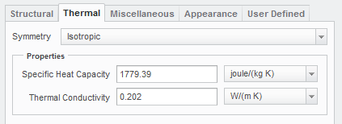
Stress Analysis – Frame 2
ROV Frame
Acrylic Material Definition
Juan

Slide 20
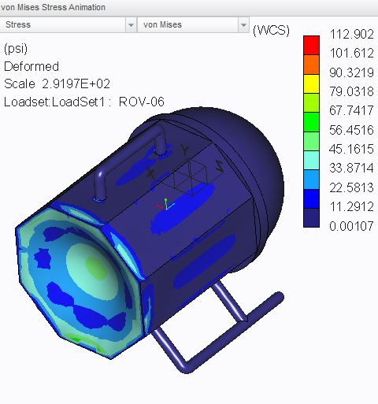
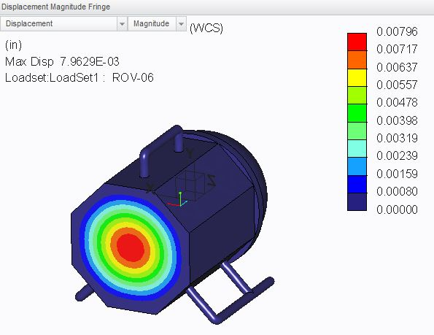
Stress Analysis – Frame 2
Displacement (in)
Von Mises Stress (psi)
Juan

Slide 21
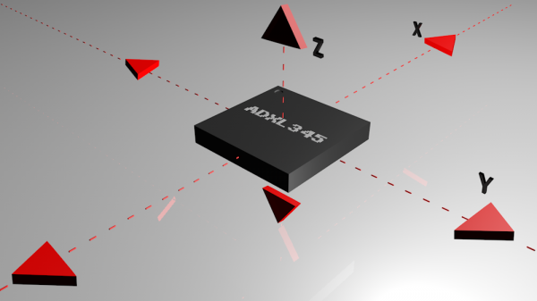
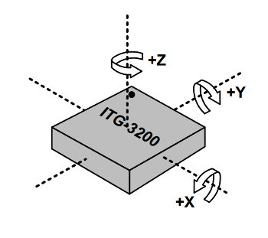
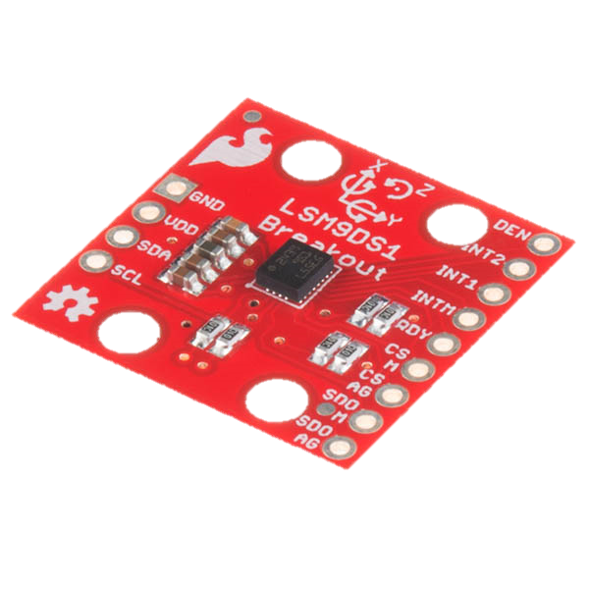
Control System
Feedback Sensors:
Accelerometer.
Gyroscope.
3-in-1 Sensor: 9 Degrees of Freedom IMU (S24.95)
3-axis accelerometer
3-axis gyroscope
3-acis magnetometer
David

Slide 22
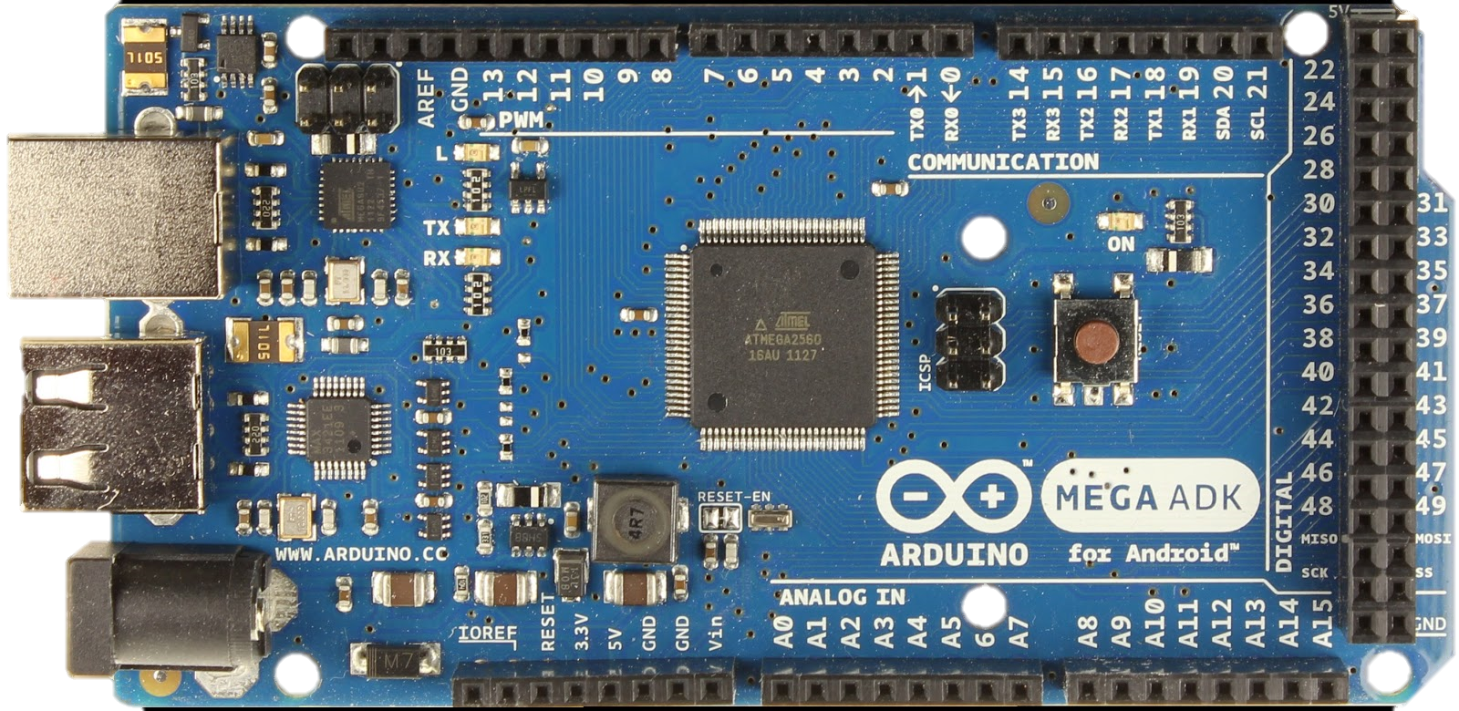
Control System
Communications:
UART.
I2C
USB Hub
David

Slide 23
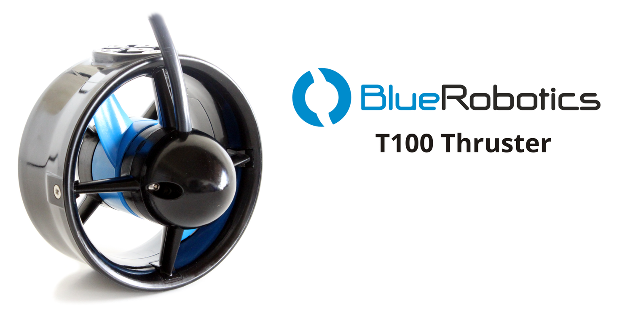
Propulsion System
Blue Robotics T100 Thruster
Price- $134.00 ea.
Motor Type- High efficiency brushless
Weight in air- 0.93 lb.
Max Power- 130W
Operating Voltage- 12 volts
Max Thrust 5.2:4 Forward (5.2 lbf) Reverse (4 lbf)
Min Thrust (0.03 lbf)
Olly

Slide 24
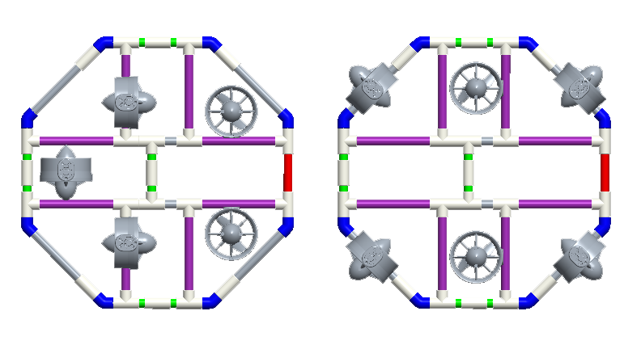


Thruster Positioning
Olly

Slide 25


Arms Update
Servo Motors vs. Stepper Motors
Servo Motor
Stepper Motor
Fast
High Torque
Accurate Rotation With Limited Angle (≈180°)
More complicated setup with PWM turning
Slow
Precise Rotation
Requires External Control Circuit or Microcontroller
Easy Set-Up & Control
Victor

Slide 26



Arms Update
Victor

Slide 27

Arms Update
Victor

Slide 28
Updated Project Budget
Current Cash Flow:
Expenditures:
CPVC components ($86.35)
Income:
No Sponsors as of 10/19
Planned Expenditures:
Final Frame - $100
Propulsion System - $800
Control System - $200
Arm Module - $700
Tether System - $200
Total - $2,000
Victor

Slide 29

Updated Gantt Chart
Gustav

Slide 30
Thank You for Listening!
Any Questions, Comments, or Concerns?

